Slide 1
EPELC Tiered Teams
Shoreline Public Schools
2019-2020 EPELC GT Team:
GT Facilitator
Admin/Coordinator
Referring Gen Ed Teacher
Notes:
Leslie
40 handouts
Sticky notes for each table
Skittles
3-2-1 (40)
This is what we do K-12, clearly defining K-6, soon 7-8th.

Slide 2
In groups of 4, share:
My personal passion in the classroom
One way I get to know my students
One word I use to describe my teaching style
One strategy I use to connect with families
Notes:
5 minutes

Slide 3

Learning Objectives
A deeper understanding of:
Supporting students systematically through the Tiered Teams process in Shoreline Public Schools
Tips for talking to families about concerns with students in your class
How students will be supported through the Guidance Team (GT) process at EPELC
Difference between GT, SST, and IEP meetings

Slide 4
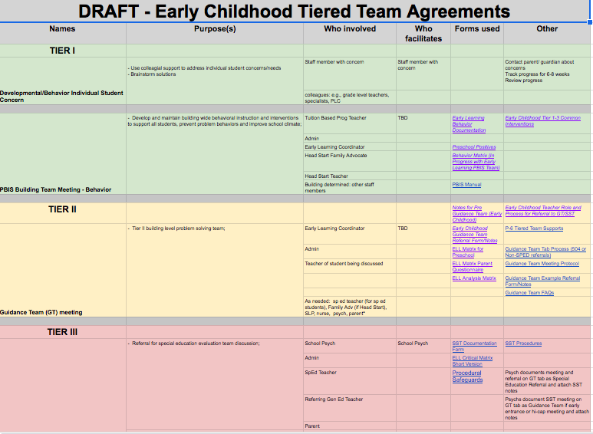
P-6 Tiered Teams
Notes:
Leslie (1 min)
District document that outlines all teams addressing academic & behavior support teams. Consistent language across all schools for GT and SST. Broken into Tier 1/2/3. Identifies name, purpose, who involved, who facilitates, forms used and other important documents.

Slide 5
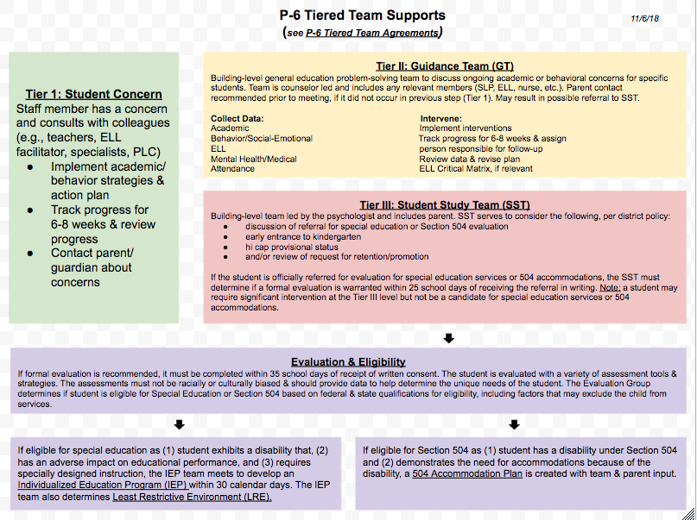
P-6 Tiered Teams Support Visual
Notes:
2 min
Flow chart visual of our student support & intervention process at Early Learning (for staff & families)
The district is rolling out the same intervention process expectations for all elementary schools
Aligns w/ Tiered Teams Agreement (previous slide) and WA state’s Multi-Tiered System of Supports (MTSS) initiative (MTSS-more acronyms!)

Slide 6
COVID-19 Considerations
Most of what we do is not changing. We will still hold meetings, communicate with parents and students, and focus on student success.
What has changed is the method for HOW we work and the expectations for what teaching and learning consists of during this remote learning phase and return to learning phases of COVID-19.

Slide 7
TIER I:
Student of Concern

Slide 8

Turn & Talk
When you have concerns about a student, what do you usually try first?
Notes:
2 mins & ask for any share outs as a group

Slide 9

Student Concern
Begin communicating with families about your concerns and intervention attempts—let them know there are concerns
Talk with your colleagues and coordinators to brainstorm ideas/interventions
Implement strategies/differentiated
instruction
Notes:
1 min

Slide 10
Student Concerns for SLP, OT, PT
If concerns about communication, contact GT Facilitator (i.e., Courtney)
  Courtney will then connect with SLPs to determine the type of communication concern (articulation and/or language) to decide which route (GT meeting or straight to SLP)
If concerns about fine or gross motor, contact GT Facilitator
  Courtney will invite OT and/or PT to GT meeting
If concerns about sensory, utilize the following steps:
  1) Implement Tier 1 and 2 strategies
  2) Consult with Guidance Team
  3) Invite OT to Guidance Team

Slide 11

How to talk to families
Start off by pointing out something positive. Name a skill or behavior the child is doing well and express how excited you are to see their progress.
If you are concerned about a child’s development, point out the specific behavior the child is struggling with and ask if they observe the same behaviors at home. It is ok to say “I may be overly concerned, but I just want to make sure”.
Use a screening tool to support your observations on the child.

Slide 12

How to talk to families
Share strategies you are trying to support the child’s development.
Let them know you will be consulting with the school team about more strategies to support their child.
Plan a time to check in again and share how strategies are going.

Slide 13
Creative Curriculum Parent Resources
**add more info here as Tier 1 strategy to try

Slide 14

Self-Reflection
On a sticky note, jot down the
following:
When connecting with families and supporting students of concern…
What’s one thing that is working well for you?
What’s one thing that you’d like to try this year?
Notes:
Take 1 minute and jot down the following. This is for you as something to keep in mind moving forward this year.

Slide 15
TIER II:
Guidance Team (GT)
Notes:
Leslie

Slide 16

The WHO
Team Members
GT Facilitators ()
Admin (Hillery Clark)
Teacher of student being discussed
As needed:
Coordinator, special education teacher (for sp ed students), family advocate (if Head Start), SLP, nurse, psych, OT, PT

Slide 17

The WHAT
GT is a general education problem solving team without the parent/guardian. It’s purpose is to provide ideas and support to the classroom teacher.
All concerns go through the GT facilitator (i.e., Courtney)
Parent contact required to alert families of concern prior to meeting, if did not occur in previous step
Notes:
2 min

Slide 18

The HOW
Teacher continues to have concern & emails GT Facilitator who provides referral form
Referral form completed by classroom teacher & returned to GT Facilitator
Action steps and interventions are determined at the meeting
  Student progress tracked for approx. 4-8 weeks (as determined by GT members) and follow up meeting scheduled, if needed
If ELL student, review of language history and ELL Preschool Critical Matrix completed
Notes:
2 min
Data collected in the areas of: academics, behavior, social/emotional, attendance, school history, language

Slide 19

What to expect at the meeting
Each meeting includes the following:
Review of student background
Desired teacher outcome
Questions
Possible solutions
Action plan
Follow-up meeting may be scheduled
Length of GT meetings approx. 25 minutes

Slide 20
TIER III:
Student Study Team (SST)
Notes:
Leslie

Slide 21
How is SST different from GT or IEP teams?
The SST is the step after other consultation and interventions with Tier 2/3 & GT have been utilized/implemented. Parents are involved.
The IEP team addresses the changing needs of students already on those plans, not the SST.
If the student has an IEP, the case manager is always first person of contact.
Notes:
Leslie (1 min)
Brief intro to SST
If the new area of concern is not related to the student’s disability (e.g., adding academics for a SLP-only student), a referral to GT may be appropriate but ALWAYS start with case manager.

Slide 22

Student Study Team (SST)
The SST team is a multi-disciplinary team that meets for the following purposes:
  To field Special Education referrals
Psychologist led and parent/guardian must be invited
A student may require significant intervention at the Tier III level but not be a candidate for Special Ed referral
Notes:
Brief intro to SST just to differentiate from GT but not purpose of our time.

Slide 23

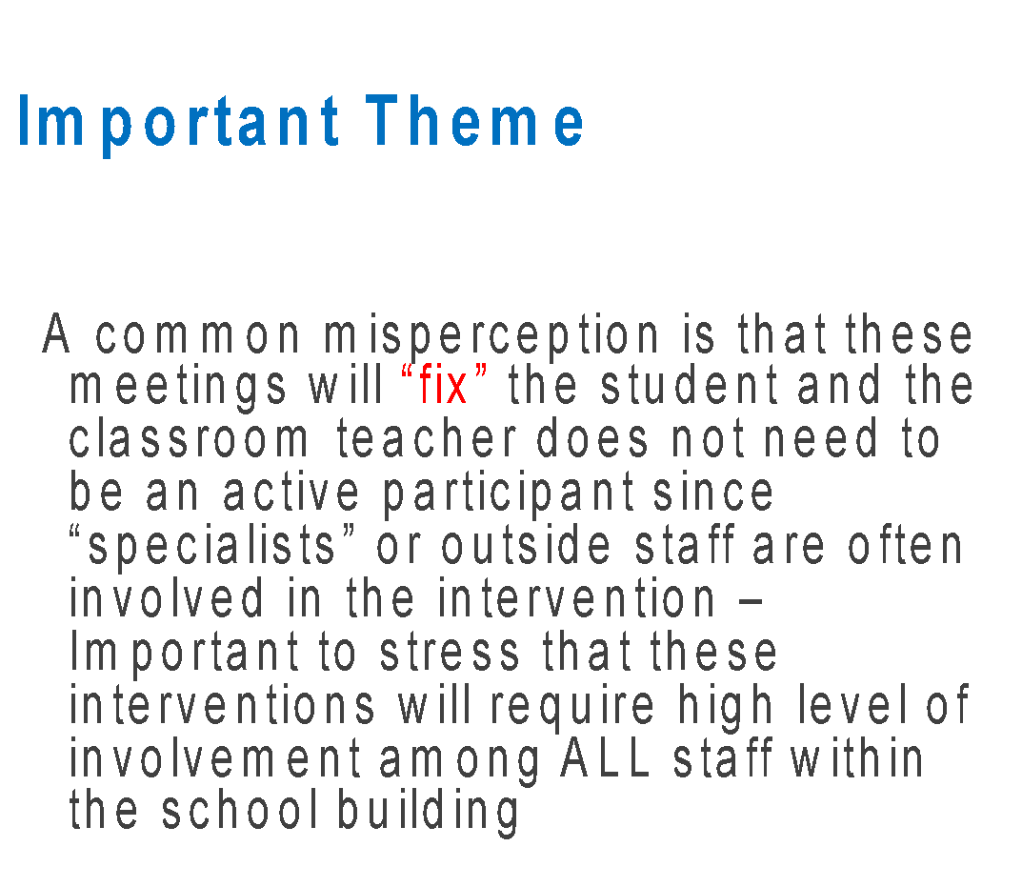
In closing…

Slide 24

Questions??
Notes:
Please complete the 3-2-1 handout which will help us know where you are at and any other questions you might have when determining how to support you this year.

